Slide 1

Automating Data Cleansing in SQL Server
Ian Fogelman
Founder / Chief Executive Data Wrangler at Database Cowboys
LinkedIn: ian-fogelman-9995a747 | www.databasecowboys.org

Slide 2

The SQL Server Agent
The following slides outline the SQL Server agent which is a key piece of the SQL Server ecosystem.

Slide 3
SQL Server Agent
SQL Server Agent is a Microsoft Windows service that executes scheduled administrative tasks, which are called jobs in SQL Server.
There are 4 main components of the SQL Server agent:
Jobs – Automated tasks or processed.
Schedules – The timetable of when a job will run.
Alerts – Notifications triggered by specific conditions.
Operators – A entity or group responsible for receiving notifications.
Citation: Microsoft, SQL Server Agent, learn.microsoft.com

Slide 4
Additional Benefits of Enabling the SQL Server Agent
Robust logging and visibility on your SQL jobs.
Retry logic
Your tasks lives in the same place as your data!

Slide 5


SQL Server Environment Overview
SQL Server (Instance)
“The data looks good dude!”
SQL Server Agent
SQL Server Job
SPX_VALIDATE_DATA
Step 1

Slide 6
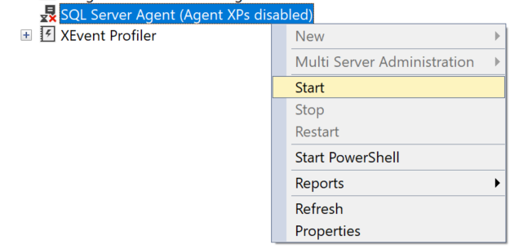
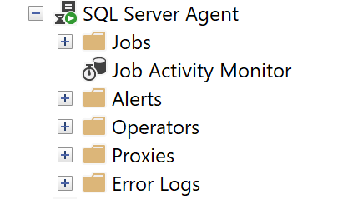
Enabling the SQL Server Agent

Slide 7

SQL Server Alerts
The following slides outline SQL Server alerts use cases, best practices, and implementation details.

Slide 8
SQL Server Alerts
An alert is an automatic response to a specific event. For example, an event can be a job that starts or system resources that reach a specific threshold. You define the conditions under which an alert occurs.
An alert can respond to one of the following conditions:
SQL Server events
SQL Server performance conditions
Microsoft Windows Management Instrumentation (WMI) events on the computer where SQL Server Agent is running
An alert can perform the following actions:
Notify one or more operators
Run a job
Citation: Microsoft, SQL Server Agent Alerts, learn.microsoft.com

Slide 9

How Can the SQL Server Agent and Alerts Help Clean Data?

Slide 10
Comparison
VS
SQL Server Agent
SQL Server Alerts
Similar to a CRON scheduler, can run jobs for you in off-hours, low utilization time frames.
Good for administrative tasks such as database backups.
Anything you can script in TSQL is fair game to run in the SQL Server Agent.
Good for notifying you about data, database specific events, or performance alerts.
Alerts can allow for a response, such as executing a job or notifying an operator group.
In the data cleansing use case, you can use alerts to let you know when you may have data quality issues.

Slide 11
In this demo, you will create a SQL Server Alert
Creating alerts is a valuable skill, in our use case we are creating alerts for a proactive data quality use case. But you can also create alerts for performance and database specific use cases.
You will create an alert, configure a response and view learn how to view alert history.
Demo

Slide 12
Create a SQL Server Job to Use Data Cleansing Stored Procedures
- In this demo, you will schedule the stored procedures created in the previous module into a SQL Server Job.
- You will also learn how to view job history and what happens when your job is unsuccessful.
Demo

